Slide 1
Community Vaccination Rate Analytics of India using QGIS
Keerthi Kesavan & Albin Gusdeve Jose
SAT5424: Population Health Informatics
Department of Applied Computing
Michigan Technological University (MTU)

Slide 2
Outlines
Introduction
Importance of Population Health
Objective
Tools and Data Source
Workflow
Choropleth maps
Conclusion and Future Work

Slide 3
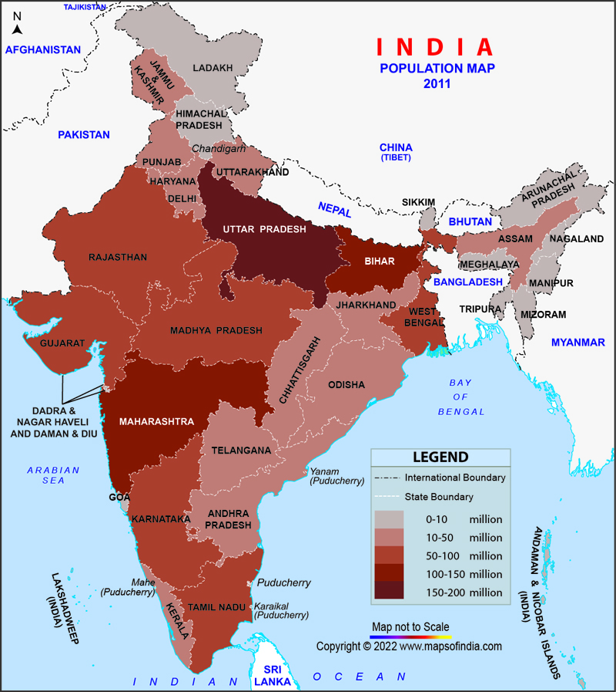
Introduction
India – Highly populated developing nation with 1.4 billion people. India is highly prone to communicable diseases and tracking them is very important.
Vaccination has been instrumental in eradicating communicable diseases in India. At present Indian government’s vaccination program provides immunization to 12 diseases and almost successfully prevented many infectious diseases from turning in to a disaster.
Geographic Information Systems (GIS) help to analyze the health patterns by integrating spatial data. It is vital in public health planning, outbreak detection, and vaccination tracking.
mapsofindia.com/maps/india/population.htm

Slide 4
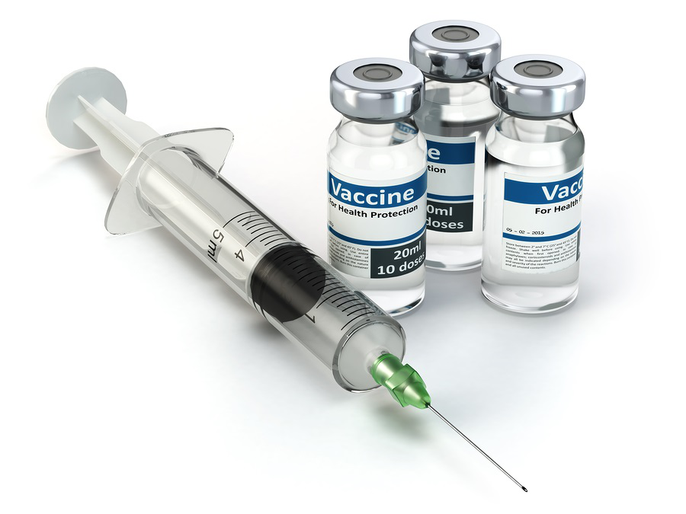
Importance of Population Health
Why this topic matters:
Addresses geographic disparities in health services.
Informs data-driven decision-making for resource allocation.
Enhances early warning systems and targeted interventions.
Actionable visualizations can empower policy-makers and healthcare providers.
Real-world applications:
Vaccine distribution optimization.
Mapping of high-risk zones for infectious diseases

Slide 5
Objective
Problem:
It is also important to closely monitor the vaccination rate in highly populated country to ensure the success rate in preventing communicable diseases.
Fragmented and underutilized health data in India, lack of geospatial analysis tools.
Solution:
Develop a GIS-based platform for disease mapping and trend analysis.
Integrate demographic and health data.
But by using QGIS platform, choropleth map of the vaccination rate can be plotted and the program can be monitored.

Slide 6
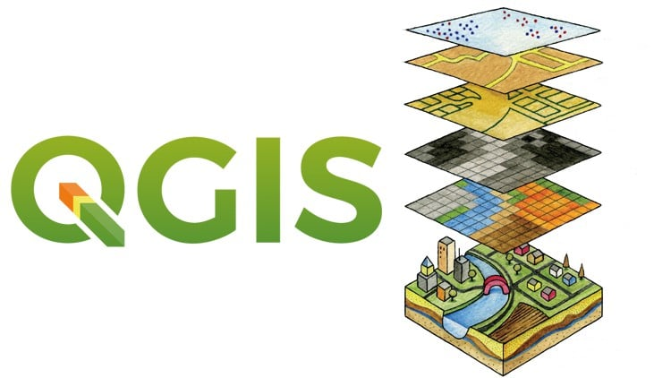
Tools and Data Source
Tools:
1. QGIS open-source Geographic Information System (GIS) software
Data source:
1. Shape files of spatial data of India (district-wise) from GADM
2. CSV files of vaccination rate from IDSP (Integrated Disease Surveillance Programme)
3. NFHS (National Family Health Survey) and Open budgets India/Data meet Github
4. Population datas: Census 2011 Govt. of India.

Slide 7
Workflow
Gather Required Data
Attribute Data (Vaccination & Disease Data)
Load Data in QGIS
Join Attribute Data to Map
Create Choropleth Symbology
Add Labels
Export

Slide 8
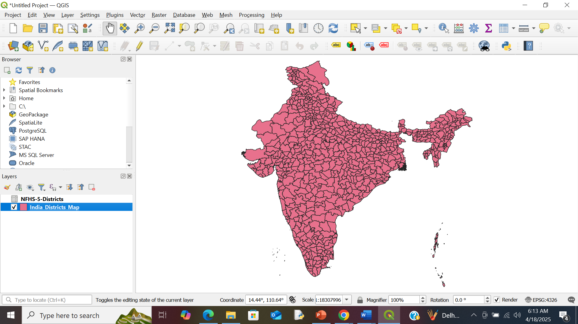
GIS Outputs and Results
Fig 1. India District-wise Map

Slide 9
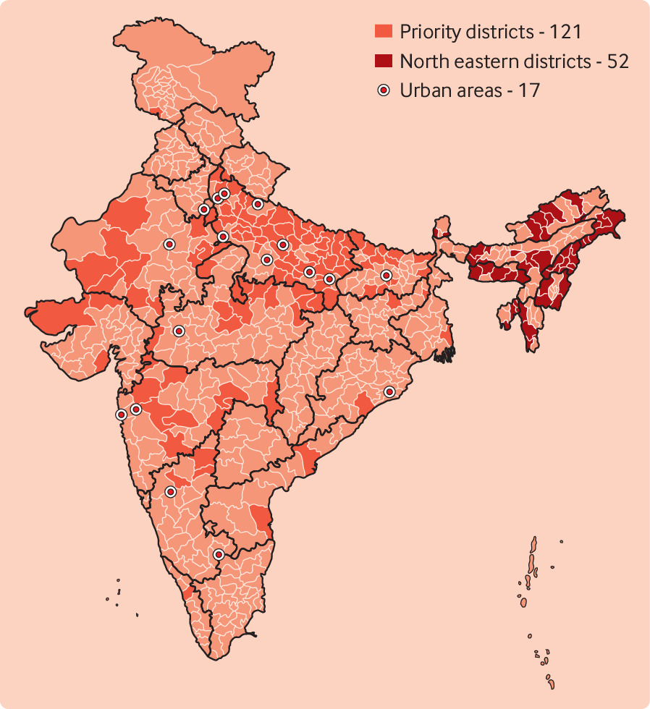
Choropleth maps of India’s Vaccination program
Fig 2. Chroropleth map Example

Slide 10
Conclusion & Impact on Population Health Field
1. Geographic Disparities: It addresses regional disparities in healthcare access and immunization by visualizing district-level vaccination rates and disease burdens.
2. Decision-making & Policy Support: The GIS-based tool provides actionable insights to policymakers and healthcare providers, enabling more targeted interventions and resource allocation.
3. Real-time Surveillance: Incorporating dashboards for real-time monitoring enhances outbreak preparedness and response.
4. Equity in Health Access: Highlights vulnerable areas, especially rural and urban slums, facilitating equity-based public health initiatives.

Slide 11
Challenges
1. Data Limitations:
Reliance on outdated datasets like the 2011 Census.
Fragmented health data across various government and non-government sources (e.g., IDSP, NFHS).
2. Limited Real-Time Access:
Lack of integration with real-time surveillance systems impedes dynamic decision-making.
3. Technical Barriers:
Learning curve for using QGIS and performing geostatistical analyses.
Challenges in integrating heterogeneous data formats (CSV, shapefiles, etc.).
4. Infrastructural Issues:
Technological disparities in rural areas may affect data input and community feedback mechanisms.

Slide 12
Related Work in This Area
Reference | Focus Area | Key Findings | Visual Aid
Johri et al. (2024) | Child vaccination | Rural under-vaccination | Choropleth map
Saran et al. (2024) | COVID-19 vaccination | Urban-rural divide | Heatmap
MoHFW (2021) | Health infra | GIS for health planning | Facility distribution map
Gurnani et al. (2018) | Immunization policy | Outreach to underserved | KPI dashboard
Ruiz & Sharma (2016) | Disease mapping | Need for GIS integration | Vector-risk maps
Johri, M., et al. (2024). Small-area variation in child under-vaccination in India: A multilevel analysis of cross-sectional data from 36 states and Union Territories, 707 districts, and 22,349 small-area clusters. The Lancet Regional Health – Southeast Asia, 32, 100504.
Saran, R. K., Kaur, L., & Kumar, S. (2024). Spatial distribution of COVID-19 vaccination across India. Department of Environmental Science, Maharaja Ganga Singh University, Bikaner. (University report; not journal-published—often cited from institutional repository)
Ministry of Health and Family Welfare (MoHFW). (2021). National Health Profile. Government of India. Retrieved from: https://www.cbhidghs.nic.in/index1.php?lang=1&level=1&sublinkid=75&lid=113
Gurnani, V., Haldar, P., Aggarwal, M. K., Das, M. K., Chauhan, A., Murray, J., et al. (2018). Improving vaccination coverage in India: Lessons from Intensified Mission Indradhanush, a cross-sectoral systems strengthening strategy. BMJ, 363, k4782.
Ruiz, M. O., & Sharma, A. K. (2016). Application of GIS in public health in India: A literature-based review, analysis, and recommendations. Indian Journal of Public Health, 60(1), 51–59.

Slide 13
Opportunities for New Areas of Research
1. Real-time Data Integration: Use of mHealth apps, IoT sensors, and crowdsourced data for live updates on outbreaks or immunization gaps.
2. Predictive Modelling: Applying AI/ML models to forecast disease outbreaks and evaluate future vaccination needs.
3. Scalability: Expanding the GIS tool for pan-India usage or customizing it for other developing regions with similar public health profiles.
4. Community Engagement: Developing mobile app interfaces to collect grassroots-level feedback on local health conditions.
5. Environmental Overlay: Studying the impact of climate, sanitation, and pollution on regional disease incidence.

Slide 14
References
Gurnani, V., Haldar, P., Aggarwal, M. K., Das, M. K., Chauhan, A., Murray, J., et al. (2018). Improving vaccination coverage in India: Lessons from Intensified Mission Indradhanush, a cross-sectoral systems strengthening strategy. BMJ, 363, k4782.
Geographic Insights Lab. (2022, July). Intensified Mission Indradhanush - Insights from ranking of key performance indicators, NFHS 2015–16 and NFHS 2019–21 (India Policy Insights Policy Brief #03). Cambridge, MA: Geographic Insights Lab, Harvard University.
World Health Organization (WHO) & United Nations Children’s Fund (UNICEF). (2024). 2023 WHO/UNICEF estimates of national immunization coverage (WUENIC) [Data set].
Johri, M., et al. (2024). Small-area variation in child under-vaccination in India: A multilevel analysis of cross-sectional data from 36 states and Union Territories, 707 districts, and 22,349 small-area clusters. The Lancet Regional Health – Southeast Asia, 32, 100504.
Saran, R. K., Kaur, L., & Kumar, S. (2024). Spatial distribution of COVID-19 vaccination across India. Department of Environmental Science, Maharaja Ganga Singh University, Bikaner.
Nalwanga, R., Natukunda, A., Zirimenya, L., et al. (2025). Assessing community vulnerability to reduced vaccine impact in Uganda and Kenya: A spatial data analysis [version 1; peer review: 1 approved with reservations]. NIHR Open Research, 5, 24.
Scotch, M., Parmanto, B., Gadd, C. S., & Sharma, R. K. (2006). Exploring the role of GIS during community health assessment problem solving: Experiences of public health professionals. International Journal of Health Geographics, 5(1), 39.
Graham, S. R., Carlton, C., Gaede, D., & Jamison, B. (2011). The benefits of using geographic information systems as a community assessment tool. Public Health Reports, 126(2), 298–303.
Ruiz, M. O., & Sharma, A. K. (2016). Application of GIS in public health in India: A literature-based review, analysis, and recommendations. Indian Journal of Public Health, 60(1), 51–59.
World Health Organization. (2020). GIS Applications in Public Health.
Ministry of Health and Family Welfare. (2021). National Health Profile. Government of India.
International Institute for Population Sciences (IIPS) & ICF. (2021). National Family Health Survey (NFHS-5), 2019-21: India. Mumbai: IIPS.
Office of the Registrar General & Census Commissioner, India. (2011). Census of India 2011.

Slide 15

Contact Information
Keerthi Kesavan, kkesavan@mtu.edu
Albin Gusdeve Jose, ajose2@mtu.edu

